Slide 1



HEART FAILURE ANALYSIS
PROJECT MENTOR: GROUP MEMBER:
PROF. ARNAB CHAKRABORTY SAI SRIJA ACHUKOLU

Slide 2
content
Project Objective & Scope
Data Description
Methodology
Data Preprocessing
Models Used
Accuracy Comparison
Benefits of the project
Future Scope of Improvements

Slide 3
Project objective: Heart failure is a critical medical condition that affects numerous individuals worldwide. By leveraging the power of artificial intelligence (AI) and machine learning (ML), we can develop predictive models to identify the risk factors associated with heart failure. In this project, we will focus on the factors of age, sex, and previous diseases undergone by individuals to predict the likelihood of heart failure. PROJECT SCOPE: The scope of this project encompasses the development and evaluation of an AI and ML-based heart failure analysis system. The project will focus on analyzing the relationship between age, sex, previous diseases undergone, and the likelihood of heart failure.

Slide 4
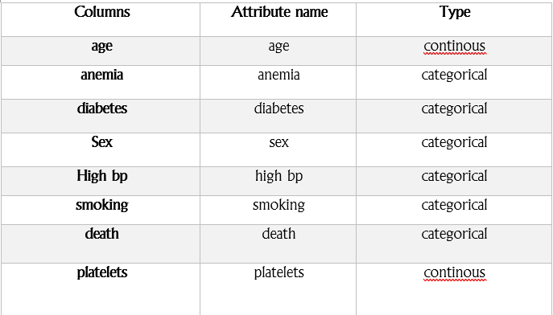
DATA DESCRIPTION The description of the data with type and description of each Attribute is given/shown in the table.

Slide 5
methodology 1)Split the data into features and target variable 2) Split the data into training and testing sets 3)Initialize models 4) Train models 5)Make predictions 6)Calculate accuracy score 7)Create a bar graph to compare accuracies

Slide 6
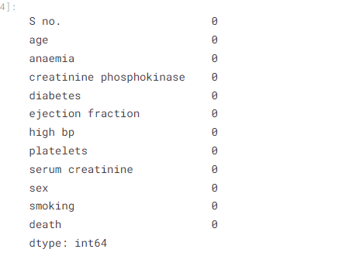
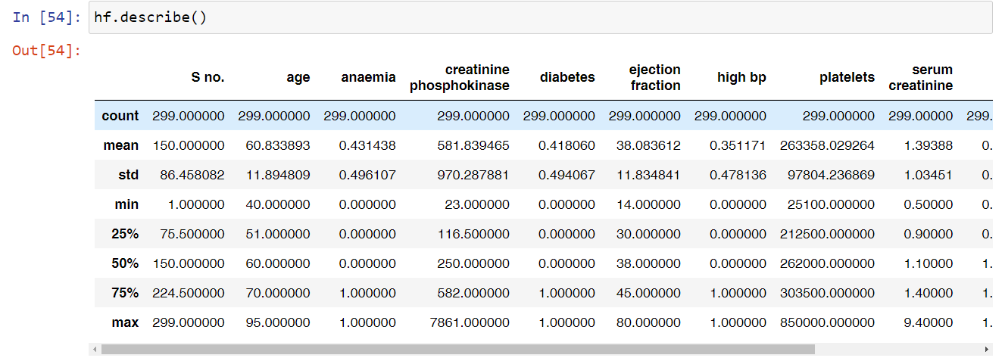
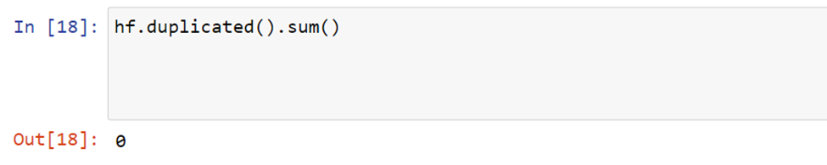
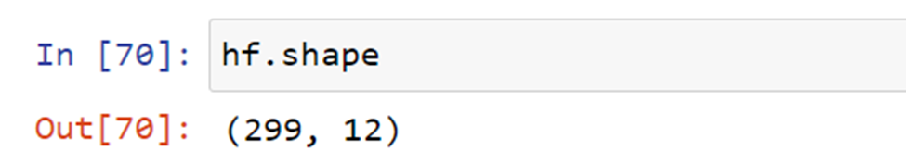
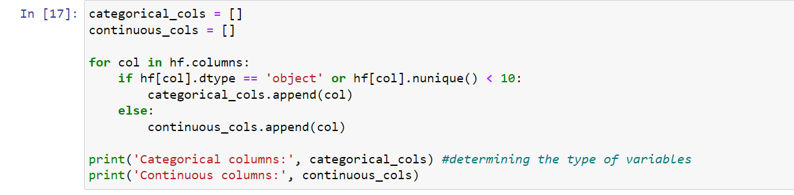
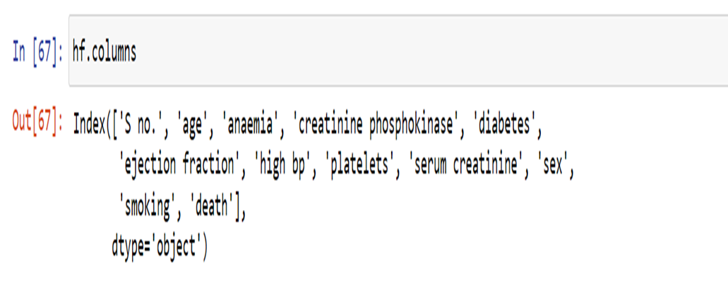
DATA preprocessing

Slide 7

Models used The Machine Learning models used for this project are: 1) randomforest classifier 2) Regression ( Logistic ) 3) Decision Tree

Slide 8
RANDOMFOREST CLASSIFIER: Random forest classifiers are called "random forests" because they are composed of multiple decision trees, and each tree is built using a random subset of the training data and a random subset of the features. This randomness helps to reduce overfitting and improve generalization. The basic idea behind a random forest classifier is to combine the predictions of multiple decision trees to make a final prediction. Each decision tree in the random forest is trained independently on a different subset of the training data. During the training process, at each node of a decision tree, a random subset of features is considered for splitting, and the best split is chosen based on certain criteria (such as Gini impurity or information gain).

Slide 9
logistic regression: Linear regression is a statistical modeling technique used to establish a relationship between a dependent variable and one or more independent variables. It assumes a linear relationship between the variables and aims to find the best-fit line that represents the relationship. The goal of linear regression is to find the equation of a straight line that minimizes the sum of the squared differences between the actual values of the dependent variable and the predicted values by the linear model. This process is known as "fitting the line" or "training the model."

Slide 10
logistic regression: The equation of a simple linear regression model with one independent variable can be represented as: Y = β0 + β1*X where: - Y represents the dependent variable - X represents the independent variable - β0 is the y-intercept (the value of Y when X is 0) - β1 is the slope (the change in Y per unit change in X)

Slide 11
decision tree A decision tree is a supervised machine learning algorithm that is commonly used for both classification and regression tasks. It is a flowchart-like structure where each internal node represents a test on a feature, each branch represents the outcome of the test, and each leaf node represents a class label or a value. 1. Decision Nodes: Internal nodes in a decision tree represent decisions or tests based on the feature values. The test at each node splits the data into two or more branches, leading to different paths in the tree based on the outcomes of the test. 2. Leaf Nodes: Leaf nodes in a decision tree represent the final predicted class label or the predicted value for a given input. They are the endpoints of the decision process.

Slide 12
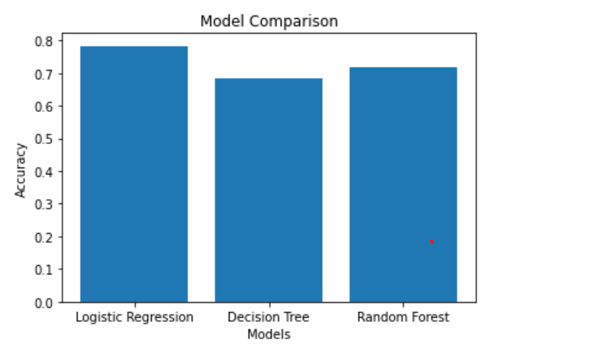
ACCURACY COMPARISION Comparing different model accuracies and visualizing them in a bar graph can provide valuable insights and help in decision-making. The bar plot when three data model accuracies are compared is as follows:

Slide 13
Benefits of this project: 1)Early Detection: Early detection of heart failure risk factors can enable timely interventions and treatments, potentially preventing or mitigating the severity of the condition. 2) Improved Accuracy: Machine learning models can analyze a wide range of patient data and identify complex patterns that may not be immediately apparent to human observers. By leveraging advanced algorithms, machine learning can provide more accurate predictions and risk assessments for heart failure. 3) Personalized Medicine: Machine learning algorithms can take into account individual patient characteristics, such as age, gender, medical history, and lifestyle factors, to create personalized models. These models can predict the likelihood of heart failure and provide tailored treatment recommendations. Personalized medicine can improve patient outcomes by considering specific factors that influence heart failure risk and response to different treatment strategies. Overall, machine learning in heart failure analysis has the potential to improve patient outcomes, optimize resource allocation, and drive advancements in cardiac healthcare by providing accurate predictions, personalized interventions, and valuable research insights.

Slide 14
future scope of improvements Heart failure analysis is an important area of research and has several potential future scope of improvements. Here are a few areas that can be explored for enhancing heart failure analysis: 1. Advanced Machine Learning Techniques: Applying more advanced machine learning algorithms and techniques can improve the accuracy and predictive power of heart failure analysis. For example, deep learning models, such as convolutional neural networks (CNNs) or recurrent neural networks (RNNs), can be explored to extract more intricate patterns and temporal dependencies in heart failure data. Real-Time Monitoring and Alert Systems: Developing real-time monitoring systems that leverage wearable devices and Internet of Things (IoT) technologies can enable continuous tracking of heart failure patients. These systems can provide timely alerts, detect early signs of deterioration, and facilitate proactive interventions to prevent adverse events.

Slide 15
future scope of improvements Feature Engineering and Selection: Developing innovative feature engineering and feature selection techniques can help identify the most relevant and informative features for heart failure analysis. This can involve incorporating domain knowledge, exploring new biomarkers or imaging features, or utilizing feature selection algorithms to automatically identify the most predictive features.

Slide 16


